Slide 1
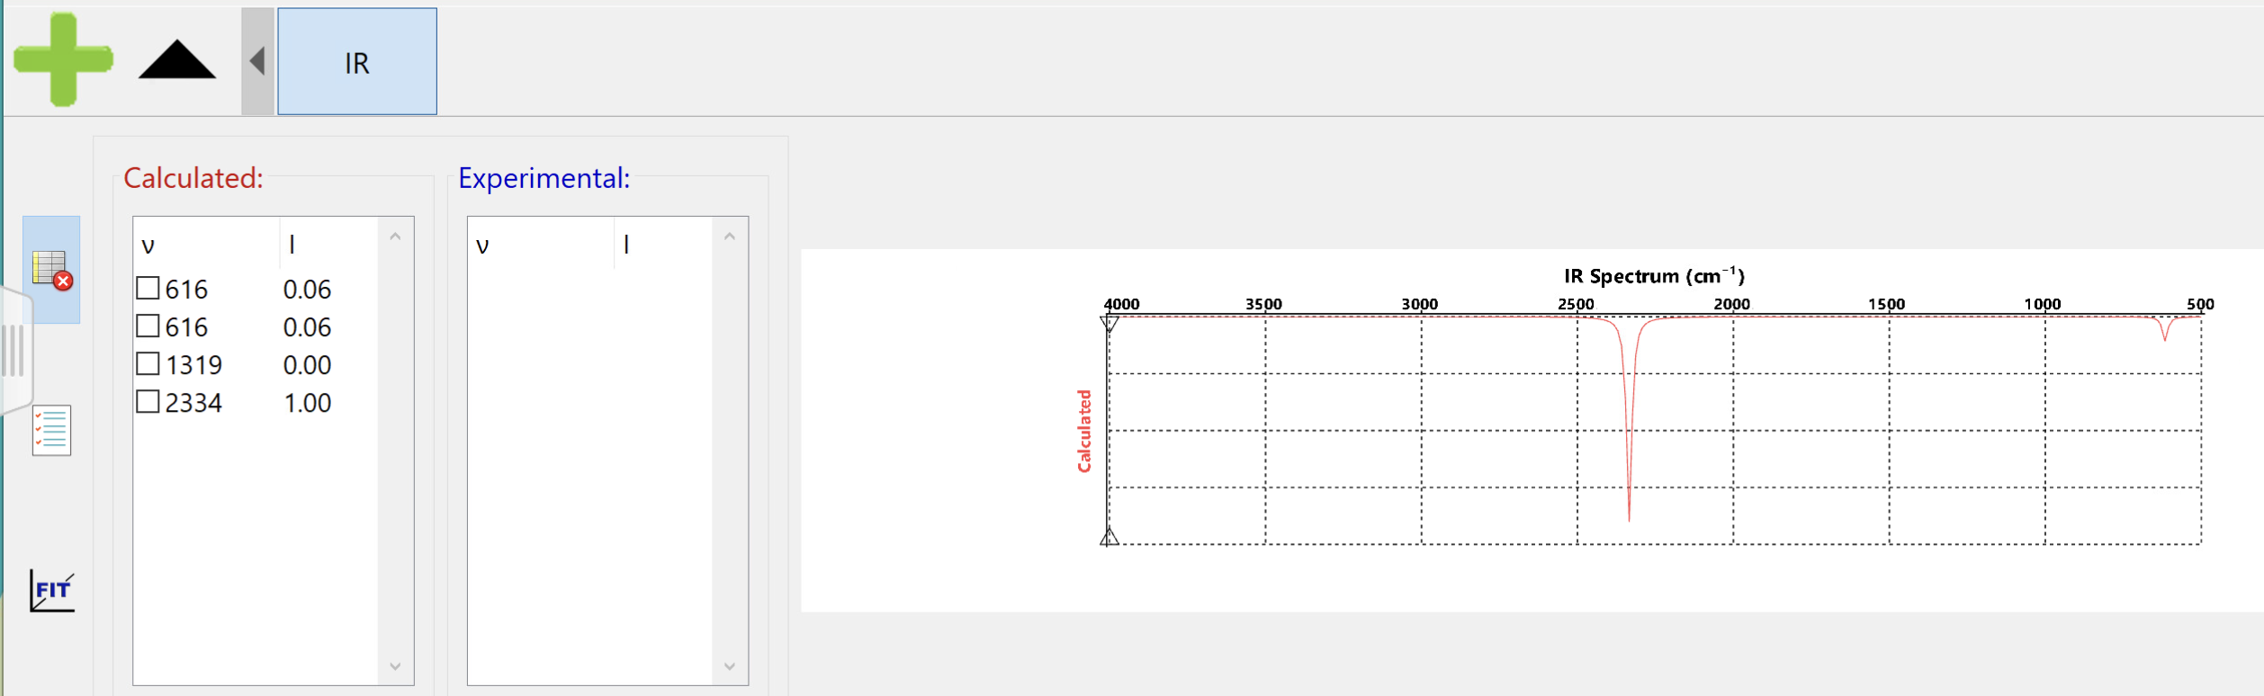
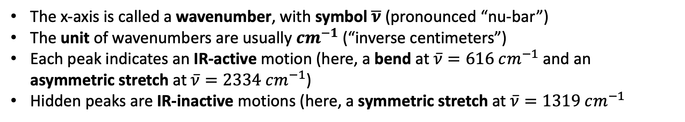
Recap: getting used to IR spectra
The x-axis is called a wavenumber, with symbol $\overline{ν}$ (pronounced “nu-bar”)
The unit of wavenumbers are usually $cm^{−1}$ (“inverse centimeters”)
Each peak indicates an IR-active motion (here, a bend at $\overline{ν}=616 cm^{−1}$and an asymmetric stretch at $\overline{ν}=2334 cm^{−1}$)
Hidden peaks are IR-inactive motions (here, a symmetric stretch at $\overline{ν}=1319 cm^{−1}$

Slide 2
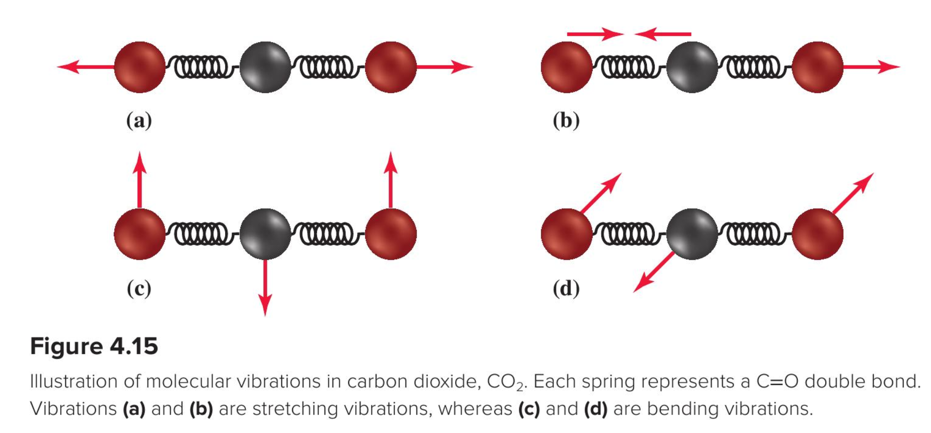
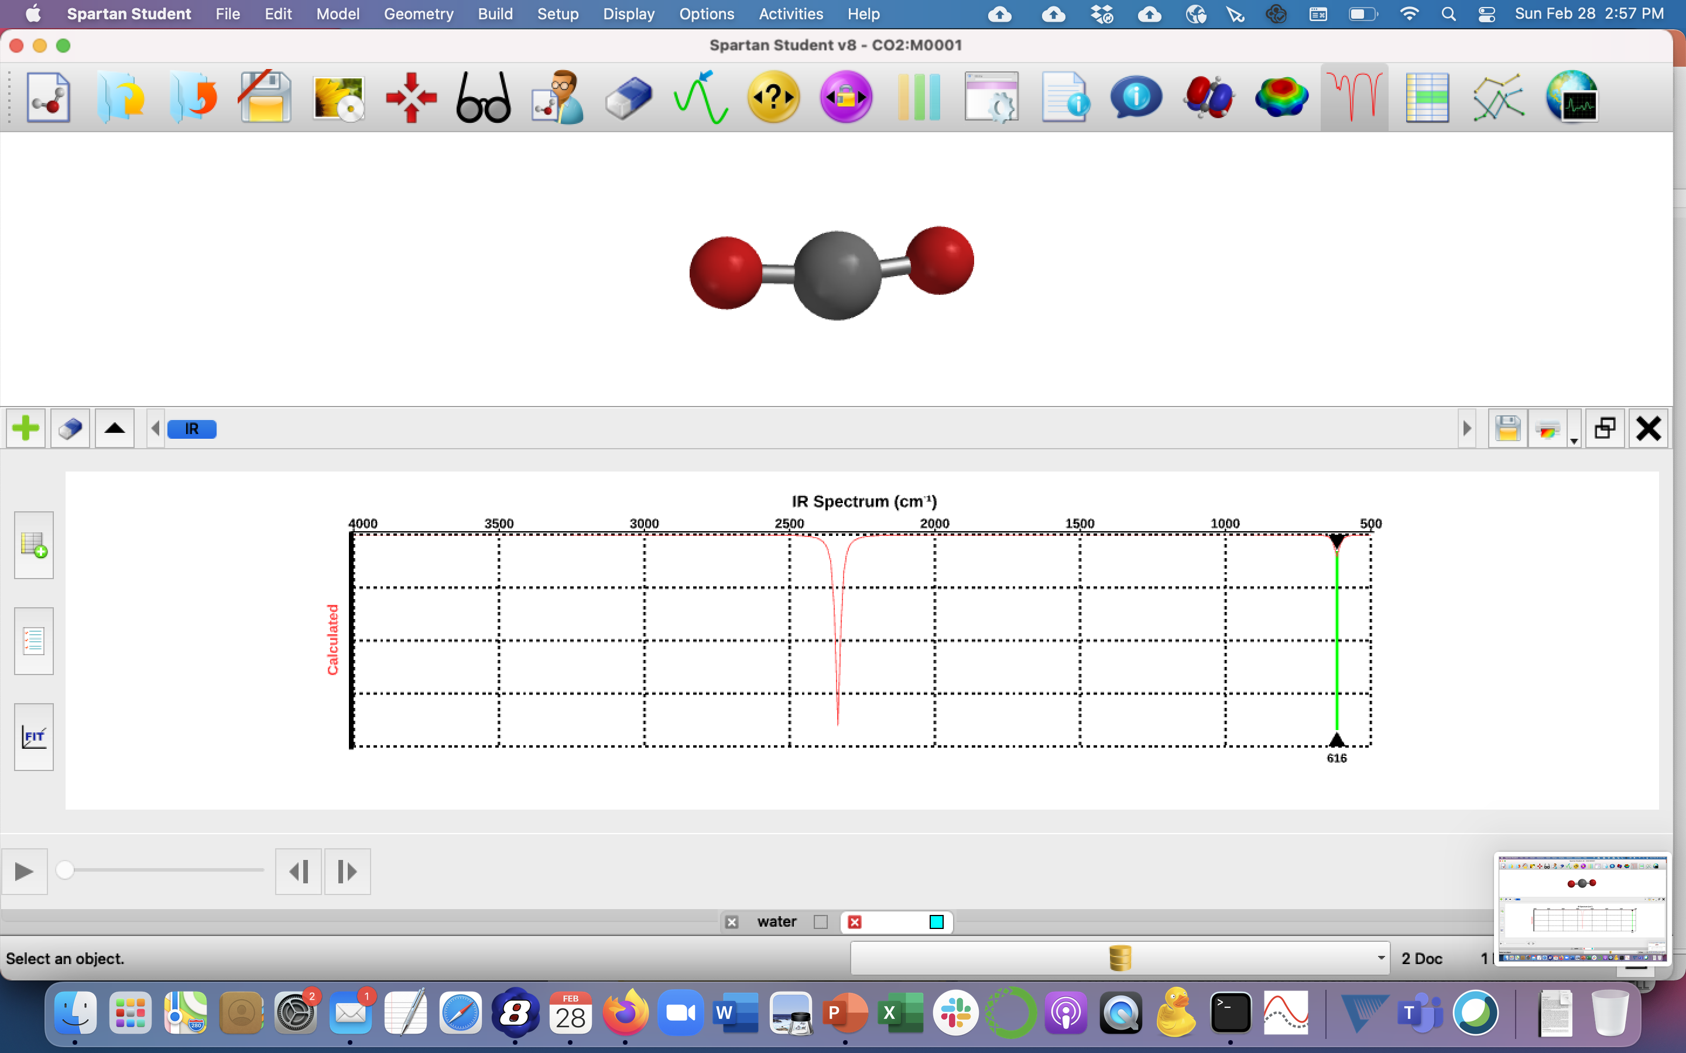
Why the bend and asymmetric stretch motions are “IR-active”
Asymmetric stretch
Bend

Slide 3
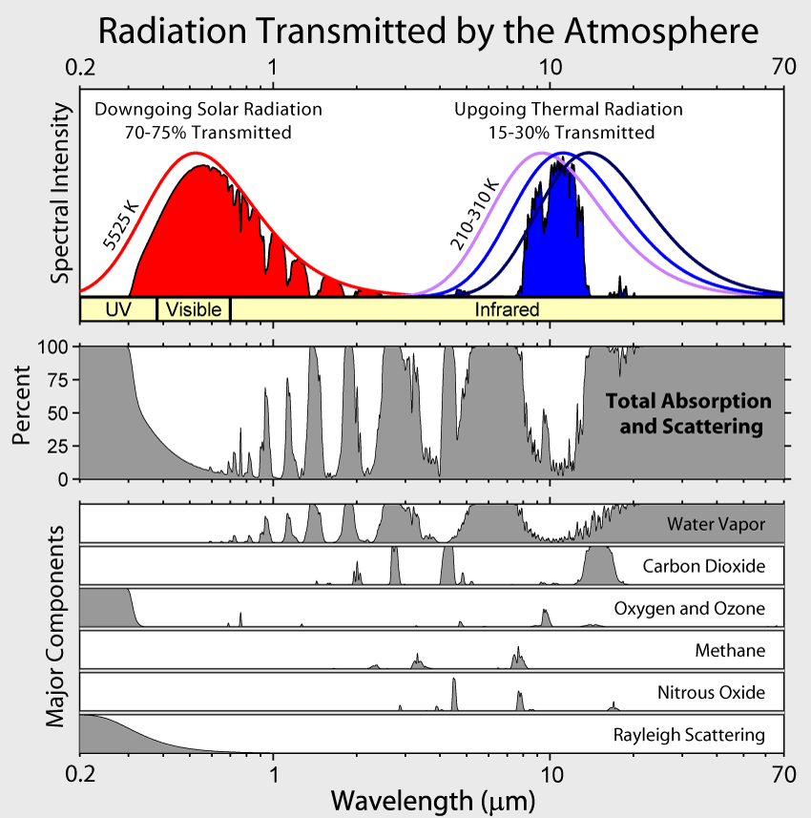
How the bend and asymmetric stretch appear in atmospheric spectra
Asymmetric stretch
Bend

Slide 4
The 8-12 micrometer atmospheric window
Water (H₂O) (most important)
Carbon Dioxide (CO₂)
Methane (CH₄)
Nitrous Oxide (N₂O)
Total GHG
H₂O bend!
CO₂ bend!
Individual GHGs

Slide 5
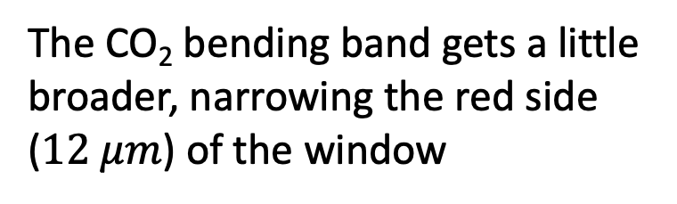
What’s the effect of increasing CO₂?
The CO₂ bending band gets a little broader, narrowing the red side ($12 μm$) of the window
Total GHG
H₂O bend!
CO₂ bend!
Individual GHGs

Slide 6
What’s the effect of increasing CO₂?
The CO₂ bending band gets a little broader, narrowing the red side ($12 μm$) of the window
Total GHG
H₂O bend!
CO₂ bend!
Individual GHGs

Slide 7
What’s the effect of increasing CO₂?
The CO₂ bending band gets a little broader, narrowing the red side ($12 μm$) of the window
Total GHG
H₂O bend!
CO₂ bend!
Individual GHGs

Slide 8
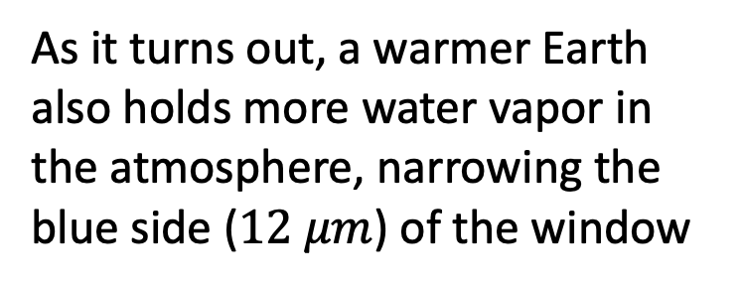
What’s the effect of increasing CO₂?
As it turns out, a warmer Earth also holds more water vapor in the atmosphere, narrowing the blue side ($12 μm$) of the window
Total GHG
H₂O bend!
CO₂ bend!
Individual GHGs

Slide 9
What’s the effect of increasing CO₂?
As it turns out, a warmer Earth also holds more water vapor in the atmosphere, narrowing the blue side ($12 μm$) of the window
Total GHG
H₂O bend!
CO₂ bend!
Individual GHGs

Slide 10
What’s the effect of increasing CO₂?
As it turns out, a warmer Earth also holds more water vapor in the atmosphere, narrowing the blue side ($12 μm$) of the window
Total GHG
H₂O bend!
CO₂ bend!
Individual GHGs

Slide 11
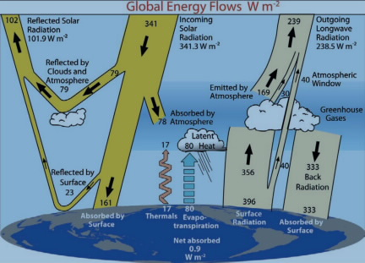
Consequences of a narrower 8-12 window
More LW captured on the way out => warmer troposphere => more Back Radiation => warmer planet surface => more surface radiation (it’s a positive feedback)
+

Slide 12
Consequences of a narrower 8-12 window
More LW captured on the way out => warmer troposphere => more Back Radiation => warmer planet surface => more surface radiation (it’s a positive feedback)
+
+

Slide 13
Consequences of a narrower 8-12 window
More LW captured on the way out => warmer troposphere => more Back Radiation => warmer planet surface => more surface radiation (it’s a positive feedback)
+

Slide 14
Consequences of a narrower 8-12 window
More LW captured on the way out => warmer troposphere => more Back Radiation => warmer planet surface => more surface radiation (it’s a positive feedback)
+
+

Slide 15
Consequences of a narrower 8-12 window
More LW captured on the way out => warmer troposphere => more Back Radiation => warmer planet surface => more surface radiation (it’s a positive feedback)
+

Slide 16
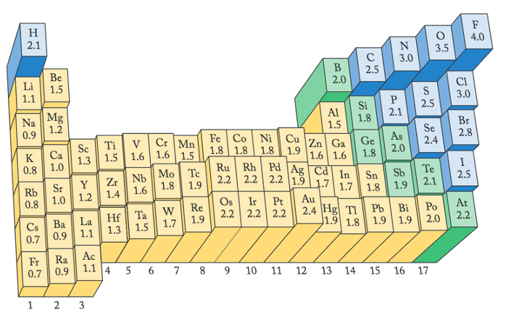
Predicting bond polarity using electronegativity
Increasing EN
EN=3.5
EN=2.5
EN=3.5

Slide 17
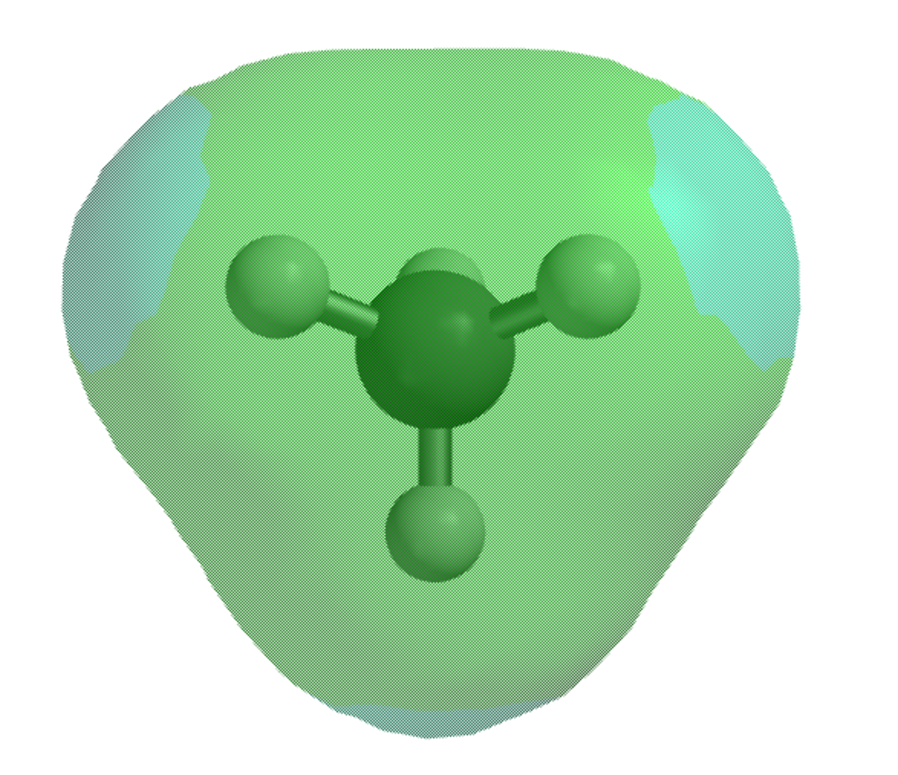
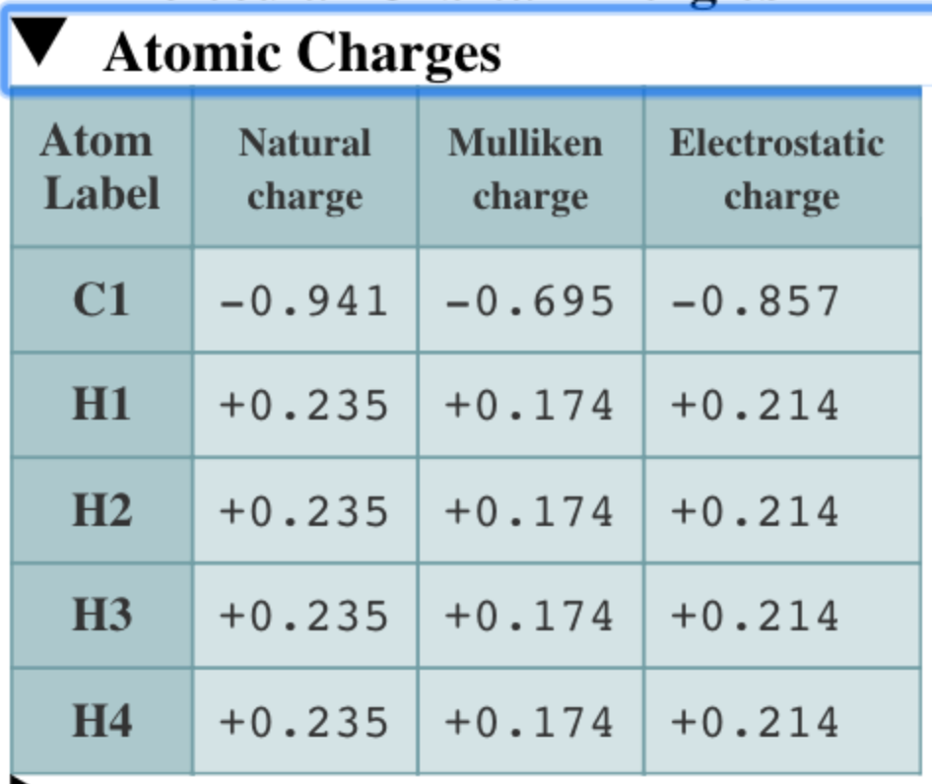
Relating electronegativity to electrostatic potential maps and partial charge

Slide 18
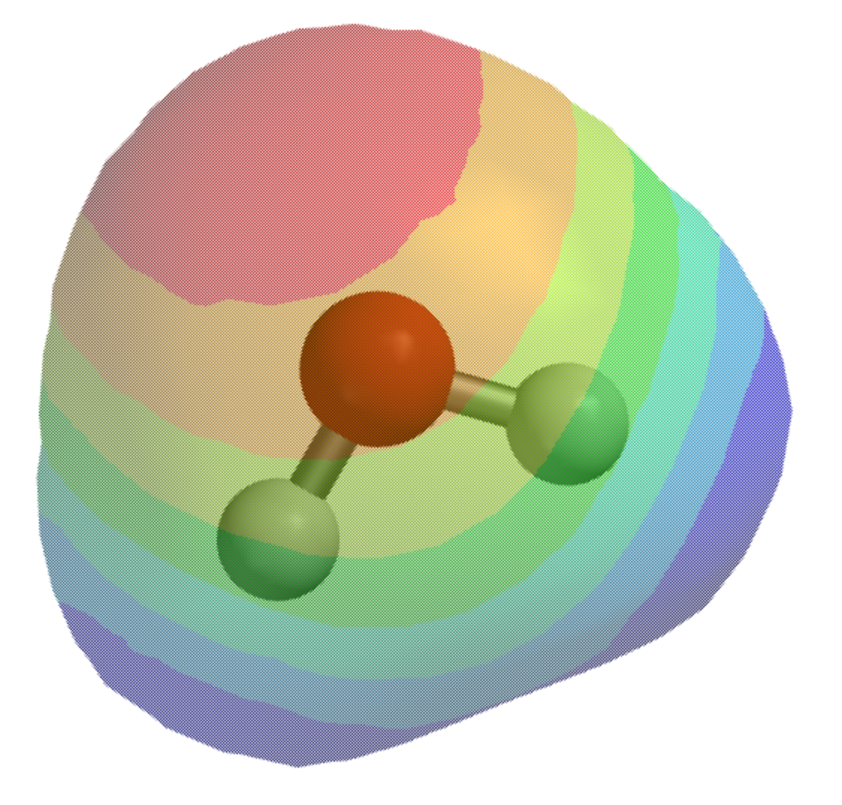
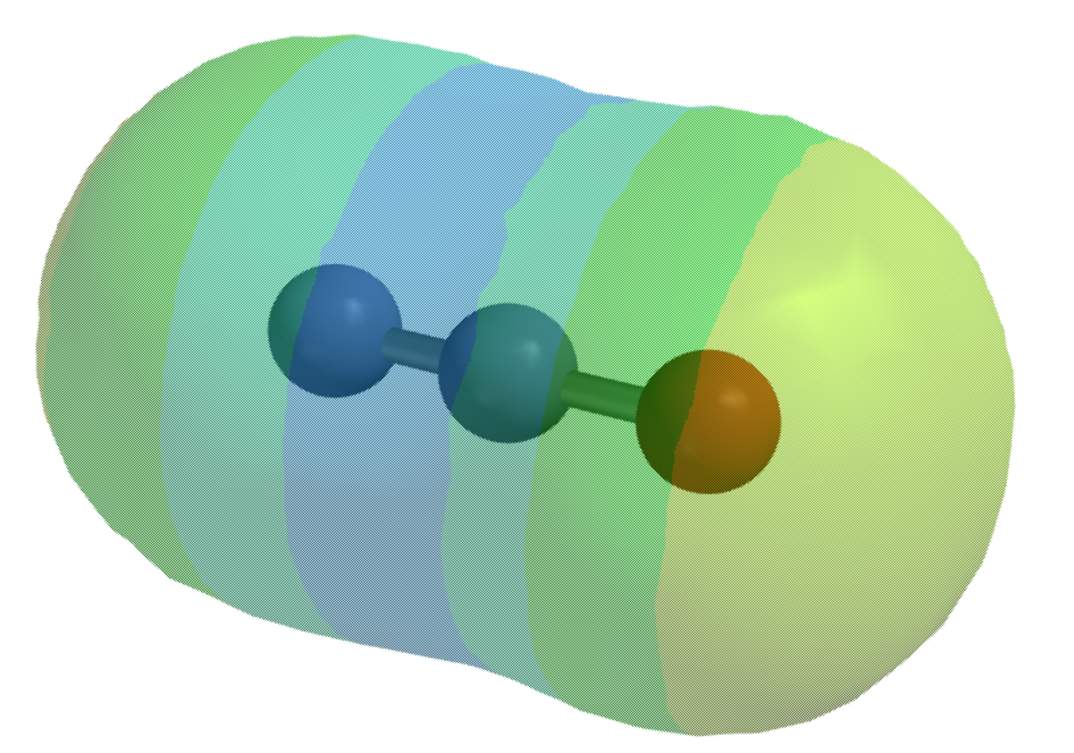
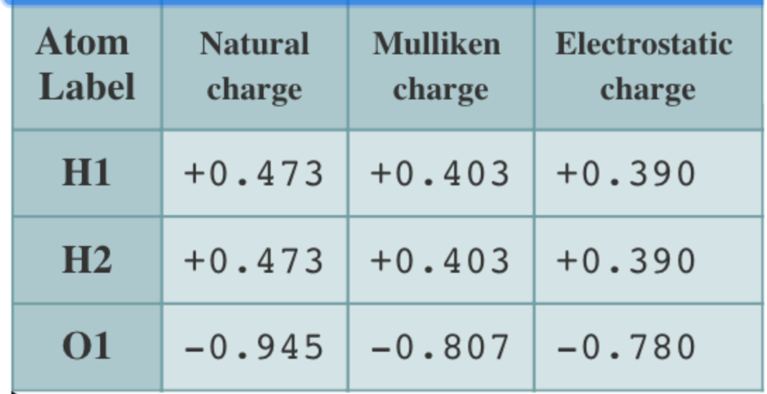
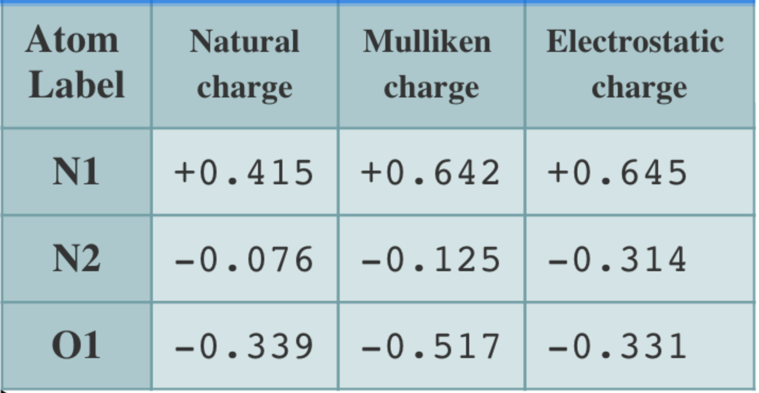
Relating electronegativity to electrostatic potential maps and partial charge

Slide 19
Other greenhouse gases

Slide 20
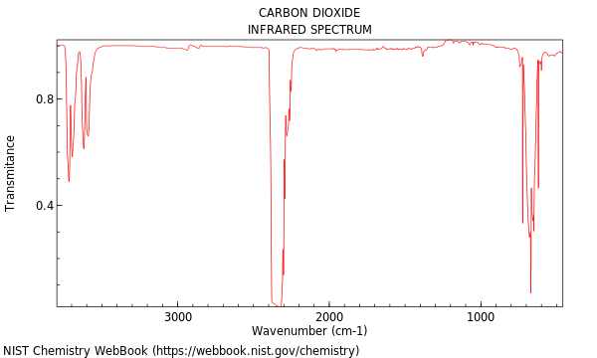
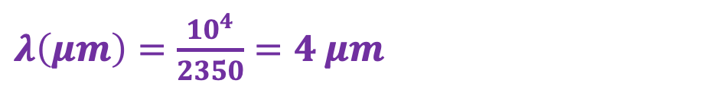
Lab this week
$λ\left(μm\right)=\frac{10^{4}}{2350}=4 μm$

Slide 21

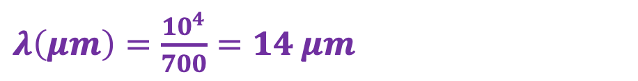
Lab this week
$$\sim 700 cm^{−1}$$
$λ\left(μm\right)=\frac{10^{4}}{700}=14 μm$

Slide 22
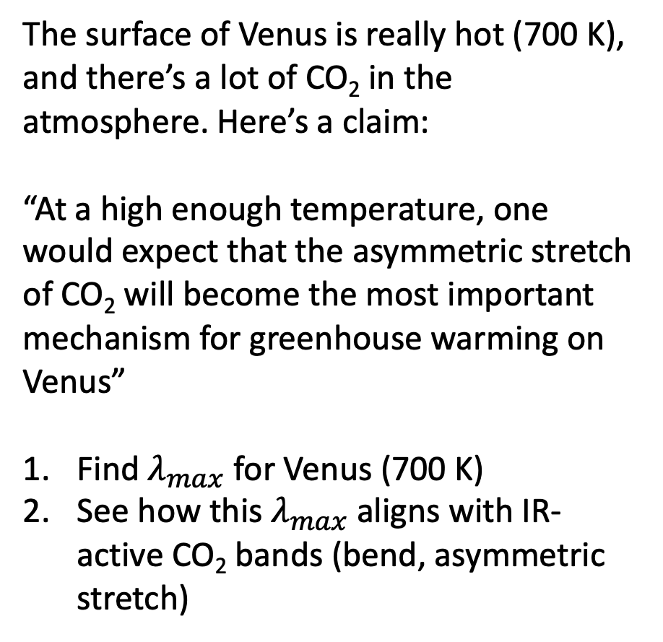
Challenge question
The surface of Venus is really hot (700 K), and there’s a lot of CO₂ in the atmosphere. Here’s a claim:
“At a high enough temperature, one would expect that the asymmetric stretch of CO₂ will become the most important mechanism for greenhouse warming on Venus”
Find $λ_{max}$ for Venus (700 K)
See how this $λ_{max}$ aligns with IR-active CO₂ bands (bend, asymmetric stretch)

